Slide 1
Objectives
Define system requirements and differentiate between functional and nonfunctional requirements.
Understand the activity of problem analysis and be able to create an Ishikawa (fishbone) diagram.
Understand the concept of requirements management.
Identify and characterize seven fact-finding techniques.
Understand six guidelines for effective listening.
Understand body language and proxemics.
Characterize the typical participants in a JRP session.
Complete the planning process for a JRP session.
Describe benefits of JRP as fact-finding technique.
Describe a fact-finding strategy that will make the most of your time with end-users.
6-<number>

Slide 2
Introduction to Requirements Discovery
Requirements discovery – the process and techniques used by systems analysts to identify or extract system problems and solution requirements from the user community.
System requirement – something that the information system must do or a property that it must have. Also called a business requirement.
6-<number>

Slide 3
Functional vs. Nonfunctional Requirements
Functional requirement - something the information system must do
Nonfunctional requirement - a property or quality the system must have
  Performance
  Security
  Costs
6-<number>

Slide 4
Results of Incorrect Requirements
The system may cost more than projected.
The system may be delivered later than promised.
The system may not meet the users’ expectations and they may not to use it.
Once in production, costs of maintaining and enhancing system may be excessively high.
The system may be unreliable and prone to errors and downtime.
Reputation of IT staff is tarnished as failure will be perceived as a mistake by the team.
6-<number>

Slide 5
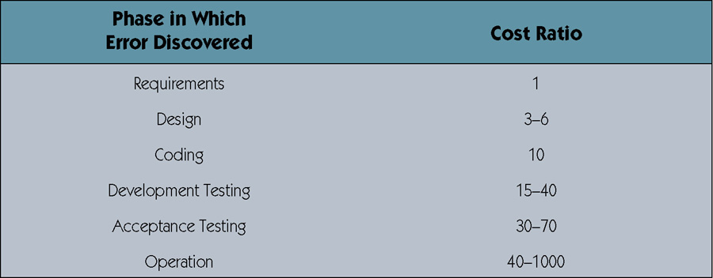
Relative Cost to Fix an Error
6-<number>

Slide 6
Criteria for System Requirements
Consistent – not conflicting or ambiguous.
Complete – describe all possible system inputs and responses.
Feasible – can be satisfied based on the available resources and constraints.
Required – truly needed and fulfill the purpose of the system.
Accurate – stated correctly.
Traceable – directly map to functions and features of system.
Verifiable – defined so can be demonstrated during testing.
6-<number>

Slide 7
Process of Requirements Discovery
Problem discovery and analysis
Requirements discovery
Documenting and analyzing requirements
Requirements management
6-<number>

Slide 8
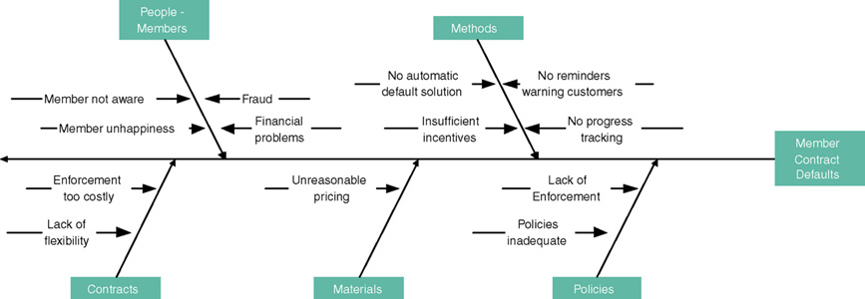
Ishikawa Diagram
Graphical tool used to identify, explore, and depict problems and the causes and effects of those problems. It is often referred to as a cause-and-effect diagram or a fishbone diagram.
  Problem at right (fish head)
  Possible causes drawn as "bones" off main backbone
  Brainstorm for 3-6 main categories of possible causes
6-<number>

Slide 9
Requirements Discovery
Given an understanding of problems, the systems analyst can start to define requirements.
Fact-finding – the formal process of using research, meetings, interviews, questionnaires, sampling, and other techniques to collect information about system problems, requirements, and preferences. It is also called information gathering or data collection.
6-<number>

Slide 10
Documenting and Analyzing Requirements
Documenting the draft requirements
  Use cases
  Decision tables
  Requirements tables
Analyzing requirements to resolve problems
  Missing requirements
  Conflicting requirements
  Infeasible requirements
  Overlapping requirements
  Ambiguous requirements
Formalizing requirements
  Requirements definition document
  Communicated to stakeholders or steering body
6-<number>

Slide 11
Requirements Definition Document
Requirements Definition Document – A formal document that communicates the requirements of a proposed system to key stakeholders and serves as a contract for the systems project.
Synonyms
  Requirements definition report
  Requirements statement
  Requirements specification
  Functional specifications
6-<number>

Slide 12
Requirements Management
Requirements management - the process of managing change to the requirements.
  Over the lifetime of the project it is very common for new requirements to emerge and existing requirements to change.
  Studies have shown that over the life of a project as much as 50 percent or more of the requirements will change before the system is put into production.
6-<number>

Slide 13
Fact-Finding Ethics
Fact-Finding often brings systems analysts into contact with sensitive information.
  Company plans
  Employee salaries or medical history
  Customer credit card, social security, or other information
Ethical behavior
  Systems analysts must not misuse information.
  Systems analysts must protect information from people who would misuse it.
Otherwise
  Systems analyst loses respect, credibility, and confidence of users and management, impairing ability to do job
  Organization and systems analyst could have legal liability
  Systems analyst could lose job
6-<number>

Slide 14
Seven Fact-Finding Methods
Sampling of existing documentation, forms, and databases.
Research and site visits.
Observation of the work environment.
Questionnaires.
Interviews.
Prototyping.
Joint requirements planning (JRP).
6-<number>

Slide 15
Sampling Existing Documentation, Forms, & Files
Sampling –process of collecting a representative sample of documents, forms, and records.
  Organization chart
  Memos and other documents that describe the problem
  Standard operating procedures for current system
  Completed forms
  Manual and computerized screens and reports
  Samples of databases
  Flowcharts and other system documentation
  And more
6-<number>

Slide 16
Things to be Gleaned from Documents
Symptoms and causes of problems
Persons in organization who have understanding of problem
Business functions that support the present system
Type of data to be collected and reported by the system
Questions that need to be covered in interviews
6-<number>

Slide 17
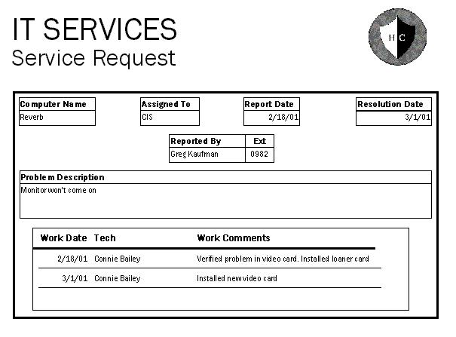
Why to Sample Completed Rather than Blank Forms
Can determine type of data going into each blank
Can determine size of data going into each blank
Can determine
which blanks
are not used
or not always
used
Can see data
relationships
6-<number>

Slide 18
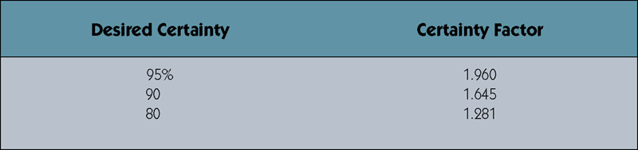
Determining Sample Size for Forms
Sample Size = 0.25 x (Certainty factor/Acceptable error) ²
Sample Size = 0.25(1.645/0.10) ² = 68
Sample Size =0.10(1 – 0.10)(1.645/0.10)² = 25
Or if analyst knows 1 in 10 varies from norm.
Certainty factor from certainty table. 10% acceptable error.
6-<number>

Slide 19
Sampling Techniques
Randomization – a sampling technique
characterized by having no predetermined
pattern or plan for selecting sample data.
Stratification – a systematic sampling technique that attempts to reduce the variance of the estimates by spreading out the sampling—for example, choosing documents or records by formula—and by avoiding very high or low estimates.
6-<number>

Slide 20
Observation
Observation – a fact-finding technique wherein the systems analyst either participates in or watches a person perform activities to learn about the system.
  Advantages?
  Disadvantages?
Work sampling - a fact-finding technique that involves a large number of observations taken at random intervals.
6-<number>

Slide 21
Observation
Advantages
Disadvantages
Data gathered can be very reliable
Can see exactly what is being done in complex tasks
Relatively inexpensive compared with other techniques
Can do work measurements
People may perform differently when being observed
Work observed may not be representative of normal conditions
Timing can be inconvenient
Interruptions
Some tasks not always performed the same way
May observe wrong way of doing things
6-<number>

Slide 22
Observation Guidelines
Determine the who, what, where, when, why, and how of the observation.
Obtain permission from appropriate supervisors.
Inform those who will be observed of the purpose of the observation.
Keep a low profile.
Take notes.
Review observation notes with appropriate individuals.
Don't interrupt the individuals at work.
Don't focus heavily on trivial activities.
Don't make assumptions.
6-<number>

Slide 23
Questionnaires
Questionnaire – a special-purpose document that allows the analyst to collect information and opinions from respondents.
Free-format questionnaire – a questionnaire designed to offer the respondent greater latitude in the answer. A question is asked, and the respondent records the answer in the space provided after the question.
Fixed-format questionnaire – a questionnaire containing questions that require selecting an answer from predefined available responses.
6-<number>

Slide 24
Questionnaires
Advantages
Disadvantages
Often can be answered quickly
People can complete at their convenience
Relatively inexpensive way to gather data from a large number
Allow for anonymity
Responses can be tabulated quickly
Return rate is often low
No guarantee that an individual will answer all questions
No opportunity to reword or explain misunderstood questions
Cannot observe body language
Difficult to prepare
6-<number>

Slide 25
Types of Fixed-Format Questions
Multiple-choice questions
Rating questions
Ranking questions
Rank the following transactions according to the amount of time you spend processing them.
___ % new customer orders
___ % order cancellations
___ % order modifications
___ % payments
The implementation of quality discounts would cause an increase in customer orders.
___ Strongly agree
___ Agree
___ No opinion
___ Disagree
___ Strongly disagree
Is the current accounts receivable report that you receive useful?
___ Yes
___ No
6-<number>

Slide 26
Developing a Questionnaire
Determine what facts and opinions must be collected and from whom you should get them.
Based on the facts and opinions sought, determine whether free- or fixed-format questions will produce the best answers.
Write the questions.
Test the questions on a small sample of respondents.
Duplicate and distribute the questionnaire.
6-<number>

Slide 27
Interviews
Interview - a fact-finding technique whereby the systems analysts collect information from individuals through face-to-face interaction.
  Find facts
  Verify facts
  Clarify facts
  Generate enthusiasm
  Get the end-user involved
  Identify requirements
  Solicit ideas and opinions
The personal interview is generally recognized as the most important and most often used fact-finding technique.
6-<number>

Slide 28
Types of Interviews and Questions
Unstructured interview –conducted with only a general goal or subject in mind and with few, if any, specific questions. The interviewer counts on the interviewee to provide a framework and direct the conversation.
Structured interview –interviewer has a specific set of questions to ask of the interviewee.
Open-ended question – question that allows the interviewee to respond in any way.
Closed-ended question – a question that restricts answers to either specific choices or short, direct responses.
6-<number>

Slide 29
Interviews
Advantages
Disadvantages
Give analyst opportunity to motivate interviewee to respond freely and openly
Allow analyst to probe for more feedback
Permit analyst to adapt or reword questions for each individual
Can observe nonverbal communication
Time-consuming
Success highly dependent on analyst's human relations skills
May be impractical due to location of interviewees
6-<number>

Slide 30
Procedure to Conduct an Interview
Select Interviewees
  End users
  Learn about individual prior to the interview
Prepare for the Interview
  interview guide
Conduct the Interview
  Summarize the problem
  Offer an incentive for participation
  Ask the interviewee for assistance
Follow Up on the Interview
  Memo that summarizes the interview
6-<number>

Slide 31
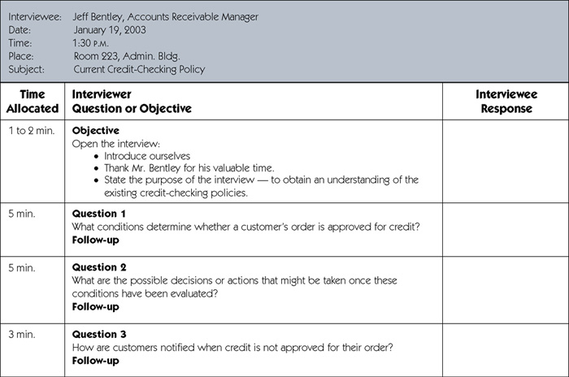
Sample Interview Guide
6-<number>
(continued)

Slide 32
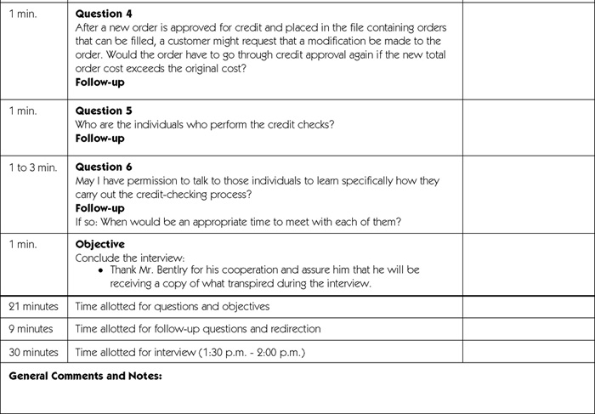
Sample Interview Guide (concluded)
6-<number>

Slide 33
Prepare for the Interview
Types of Questions to Avoid
  Loaded questions
  Leading questions
  Biased questions
Interview Question Guidelines
  Use clear and concise language.
  Don’t include your opinion as part of the question.
  Avoid long or complex questions.
  Avoid threatening questions.
  Don’t use “you” when you mean a group of people.
6-<number>

Slide 34
Conduct the Interview
Dress to match interviewee
Arrive on time
  Or early if need to confirm room setup
Open interview by thanking interviewee
State purpose and length of interview and how data will be used
Monitor the time
Ask follow-up questions
  Probe until you understand
  Ask about exception conditions ("what if...")
6-<number>

Slide 35
Interviewing Do’s and Don’ts
Do
Don't
Dress appropriately
Be courteous
Listen carefully
Maintain control of the interview
Probe
Observe mannerisms and nonverbal communication
Be patient
Keep interviewee at ease
Maintain self-control
Finish on time
Assume an answer is finished or leading nowhere
Reveal verbal and nonverbal clues
Use jargon
Reveal personal biases
Talk more than listen
Assume anything about the topic or the interviewee
Tape record (take notes instead)
6-<number>

Slide 36
Body Language and Proxemics
Body language – the nonverbal information we communicate.
  Facial disclosure
  Eye contact
  Posture
Proxemics – the relationship between people and the space around them.
  Intimate zone—closer than 1.5 feet
  Personal zone—from 1.5 feet to 4 feet
  Social zone—from 4 feet to 12 feet
  Public zone—beyond 12 feet
6-<number>

Slide 37
Discovery Prototyping
Discovery prototyping – the act of building a small-scale, representative or working model of the users’ requirements in order to discover or verify those requirements.
6-<number>

Slide 38
Discovery Prototyping
Advantages
Disadvantages
Can experiment to develop understanding of how system might work
Aids in determining feasibility and usefulness of system before development
Serves as training mechanism
Aids in building test plans and scenarios
May minimize time spent on fact-finding
Developers may need to be trained in prototyping
Users may develop unrealistic expectations
Could extend development schedule
6-<number>

Slide 39
A Fact-Finding Strategy
Learn from existing documents, forms, reports, and files.
If appropriate, observe the system in action.
Given all the facts that already collected, design and distribute questionnaires to clear up things that aren’t fully understood.
Conduct interviews (or group work sessions).
(Optional). Build discovery prototypes for any functional requirements that are not understood or for requirements that need to be validated.
Follow up to verify facts.
6-<number>

